Slide 1
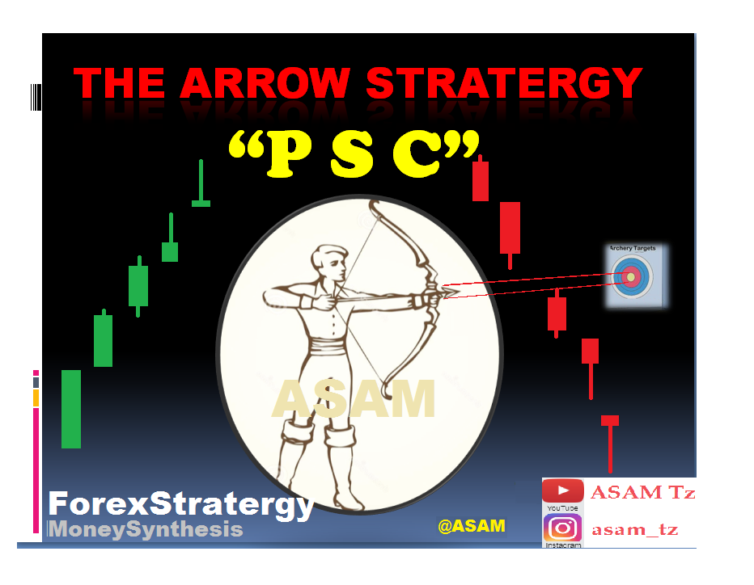
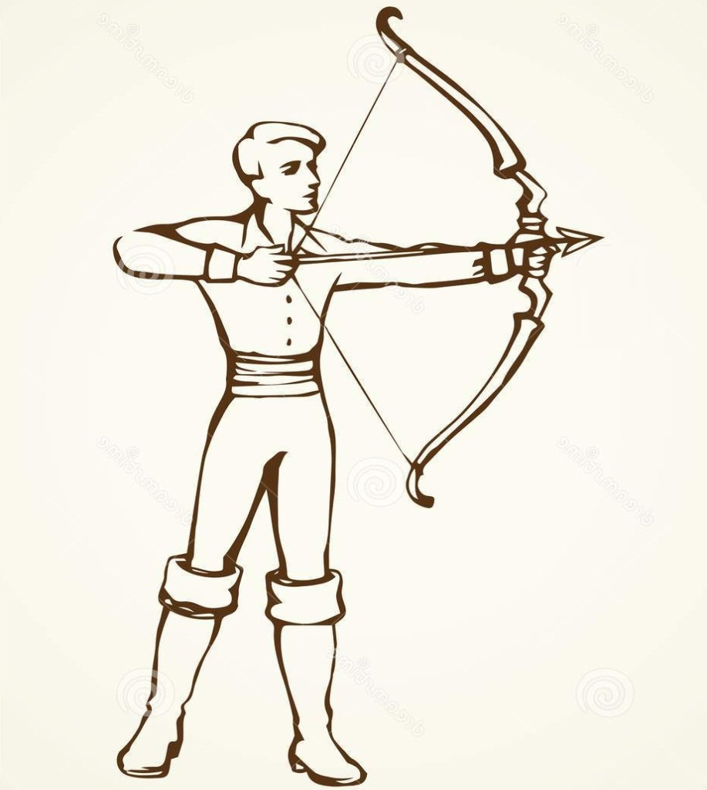
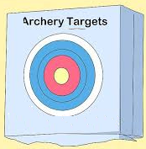
THE ARROW STRATERGY
“P S C”
By Y Leez
MoneySynthesis

Slide 2
ARROW STRATEGY (PSC)
This is the trading strategy which is based on ELLIOTT waves movement of price. Therefore is the strategy that help traders to put knowledge about Elliot waves into action or practice. The principle states that “In any trending market, Pullback is the Setup for the Comeback” (PSC).
Trending market is the one moving in upward or downward direction. But the movement is not smooth toward the direction of trend, instead the price moves forward and pulls back be fore it continues with the major trend.

Slide 3
Pull back is believed to be a point where price finds additional force to continue with the movement in direction of major trend.
Hence this resemble the process of shooting with an ARROW, therefore the pullback is the setup which build a force in order to shoot hence “you will never shoot unless you pull it back”. While pulled back, there will be a setup for the comeback i.e. to continue with the forward move.

Slide 4
Based on Elliott waves movement you will be able to shoot wave number “3” and wave “C” with minimal risk but at your own risk you can shoot wave number “5”.
Arrow (PSC) waves Principles.
Pullback in wave # 2 is a setup for wave # 3.
Pullback in wave # 4 is a setup for wave # 5.
Pull back in wave “B” is the setup for wave “C”.
Additionally, there is pull back in wave “X” which gives a setup for waves “Y” and “Z”, this applies when there is combination of corrective waves e.g. WXY or WXYXZ.

Slide 5
HOW TO TRADE WITH ARROW STRATEGY.
ENTRY.
You will enter the market at two different points / areas depending on your money management rules and market entry principles.
Validation (valid) zone.
This is the first market entry point based on arrow strategy, where it defines the area where a market start to make a significant turn (major turning point). Based on PSC principles it is a point where a particular shoot begins before it goes beyond the previous swing High or Low. Specific entry will be obtained through observing various candle stick formations (patterns).

Slide 6
The significance of entering the market through this point (valid zone) is that, it gives high REWARD to RISK ratio, but the probability of loosing the trade i.e. market turning to the other side is also high.
ii. Confirmation point (zone).
This is the second point that you can enter the market based on PSC strategy. Confirmation point is the area beyond the previous swing High or Low. Specific entry will be obtained after price has broken this zone (confirmation zone) and retested it. Then observe various candle formations in order to enter the trade.

Slide 7
Significance of taking trade at confirmation zone is that, it gives high probability of trade to reach the target (more safe) but the reward is in some way minimum compared to trade taken at validation zone.
Therefore it remains to be you choice either to take trade at validation zone or at confirmation zone.

Slide 8
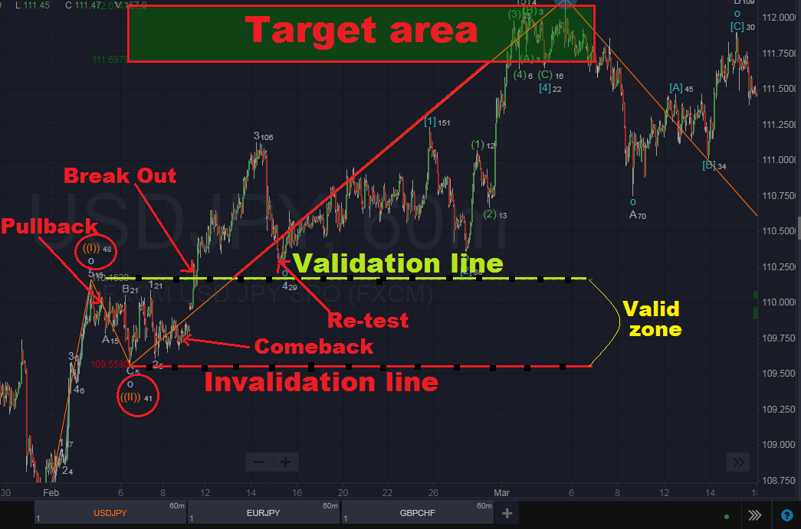

Slide 9
STOP LOSS.
The point for stop loss will relate with your entry point i.e. you take a trade at validation zone or at confirmation zone.
For trade made within validation zone stop loss is placed few cents below or above (out of) the invalidation zone. Because this is the point which when reached by price defines the incorrectness of your predicted movement of price to a particular direction (invalidate the trade).

Slide 10
For trade taken at confirmation point (zone), stop loss is placed few cents below the valid zone (validation line), but you money management rules can be applied to determine the exact point for stop loss.
In general, based on the ARROW STRATEGY, stop loss should be placed at the point where when reached by price shows that the predicted direction is not true or is invalid. This point is known as INVALIDATION POINT.

Slide 11
Take profit.
When trading with ARROW strategy (PSC), the target price to be reached is determined through various ELLIOTT waves relations, these are: -
Wave ratios e.g. wave C to A is 1.0 ratio.
Fibonacci tool e.g. wave 3 is frequently 161.8 Fibonacci extension.

Slide 12
GENERALIZATION
Arrow trading strategy is purely an application of ELLIOTT wave theory, therefore you can not trade through it if you are not aware with ELLIOTT theory.
Elliott wave theory is not working alone in ARROW strategy, therefore other principles can be applied for maximizing profit. So you can use this strategy in any trading platform and systems with other additional rules for maximizing profit.

Slide 13
Watch a video on how the ARROW STRATEGY works. Follow the link below: -
https://www.youtube.com/watch?v=45naefkj2Is&t=492s
Trade with arrow strategy by using WAVEBASIS trading platform.
https://app.wavebasis.com
NOTE: Arrow strategy can work in any trading platform provided that you apply ELLIOTT wave principles.
“THANK YOU ALL”

